Slide 1
Sacred Trusts
(part 3)

Slide 2
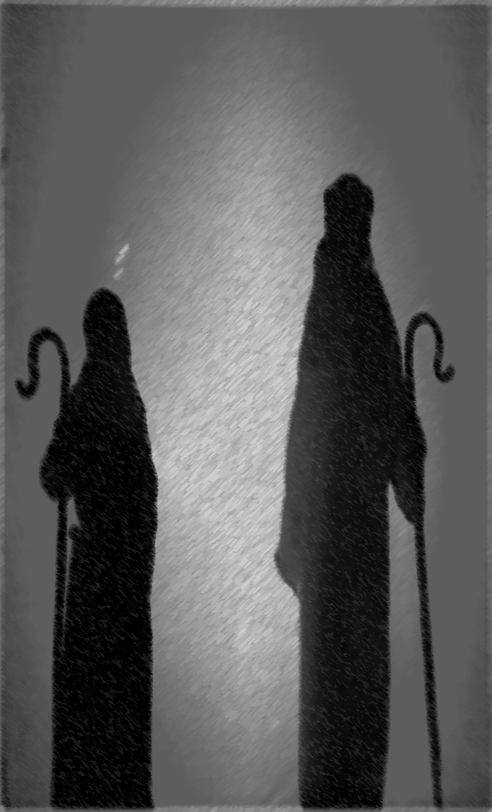
ELDERS
“Therefore take heed to yourselves and to all the flock, among which the Holy Spirit has made you overseers, to shepherd the church of God which He purchased with His own blood” (Acts 20:28)
Sacred Rulers
4
Notes:
This statement in Acts 20:28 was not made to evangelists, but to certain men appointed to and recognized as “elders” in the church (see Acts 20:17). The eldership of Ephesus is here admonished to take heed, both to themselves and to all the flock. Elders need to always be watching out for each other as well as watching over the flock, or local church. We see that God died to purchase the church (that is what our sins cost); and that God also provides an oversight for the church. There is both the payment to set us free and the guiding to keep us safe and help us grow in the grace of God. The significance which God has placed upon this type of leadership and oversight in the church cannot be downplayed or ignored.
We see that the flock is entrusted to them as well as they are entrusted to the flock by the Holy Spirit of God.

Slide 3
Titus 1:5
“For this reason I left you in Crete, that you should set in order the things that are lacking, and appoint elders in every city as I commanded you—”
Paul and Titus were both in Crete
Titus was left there to promote spiritual growth
Worked with local churches in several cities
Work to appoint elders
Implies none met the qualifications when Paul was there
Qualifications (1:6-9) show marks of spiritual maturity for the office

Slide 4
Titus 1:6a
1) GENERAL QUALIFICATION
“if a man is blameless…”
Has no indictment against him; without an accusation
From God’s word
From family
From within or without the body
Does not mean sinless
Does not mean he can never sin
“once and elder” is not “always an elder” (Acts 20:28-30; 1 Tim. 5:19, 20)

Slide 5
Titus 1:6b
2) DOMESTIC QUALIFICATIONS
“… the husband of one wife, having faithful children not accused of dissipation or insubordination”
Is he the husband of one wife?
Are his children “faithful” and “steadfast” (YLT)
Are his children “accused” of “dissipation?”
Are they wild, wasteful and self-indulgent?
Are his children “accused” of “insubordination?”
Are they rebellious or do they submit to God’s word and their father’s leadership (1 Tim. 3:4, 5)?

Slide 6
The family is a proving ground of a man’s character
BLAMELESS DOMESTIC BLAMELESS
“⁶ if a man is blameless, the husband of one wife, having faithful children not accused of dissipation or insubordination.
⁷ For a bishop must be blameless, as a steward of God…”
Notes:
We see his domestic life sandwiched between the quality of being blameless and it is this quality that I suggest is stressed throughout these qualifications. It is a thought that is to run through them. “For” relates what has been discussed with what follows. Since he is a steward of God, that is, since the responsibility of caring for God’s church is entrusted to him, he ought to be without accusation both in his family life as well as his personal character. We see his character as a display of the character of the One who first entrusted him with a family and then with God’s family, the church. Finally, notice that “church government” is of divine appointment. It is “of God.”

Slide 7
Titus 1:7
3) PERSONAL QUALIFICATIONS –in the negative
“…not self-willed, not quick-tempered, not given to wine, not violent, not greedy for money”
Self-willed (self-pleasing)
Quick-tempered (prone rather than slow to anger, irritable)
Given to wine (Gk. paroinos: par, with or near; oinos, wine)
Should be one who stays away from it (cf. Prov. 23:29-32|22:24, 25|5:8, 9)
Violent (bruiser)
Greedy for money (1 Pet. 5:2; 1 Tim. 3:3)
Notes:
Self-willed – is a person who frames the world around himself. The opinions and decisions must always be acceptable to his will. He seldom gives up his will and if he does, he does so grudgingly. Let a man be blameless in self-will.
Violent, this is a man who resorts to physical force to settle an issue. One might think, why would Paul even have to list this. Should this be a known? When you think of people being converted out of the world, even this basic Christian trait has to be something that is taught. Think of those Jews, who were religious and yet sought to silence Paul through violence. We can also imagine the barbarians in life who need to know that things can be solved without your fist having an appointment with someone’s face.
What might be the problems an eldership that is greedy for gain? Greedy people strive to lay up treasures here on earth rather than in heaven. They might adopt false doctrines that have a financial impact on the church. They might not want to financially support the preaching of the gospel or neglect good teaching material due to cost rather than need. They might also be subject to swindle the church for personal gain. Yet, in all of this, we should recognize that elders are worthy of wages, especially those who regularly labor in the word (1 Tim. 5:17, 18).

Slide 8
Titus 1:8
3) PERSONAL QUALIFICATIONS –in the positive
“but hospitable, a lover of what is good, sober-minded, just, holy, self-controlled”
Hospitable (a lover of strangers, YLT)
A lover of what is good (a lover of good men, YLT)
Sober-minded (a sound mind, prudent, sensible)
Just (upright and fair, without partiality)
Holy (not polluted but separated, 1 Tim. 2:8)
Self-controlled (rightly possessing your passions)
Notes:
Christ’s religion is not only negatives, but also positives for fruit bearing.
HOSPITALITY – is also something that stems from love (1 Pet. 4:8, 9). It is a trait that all Christians are to seek to excel in how to love beyond our sphere (see also 3 Jn. 5, 6). The absence of such is what brought on the judgment of hell in Matthew 25:41ff.
Lover of good – the elder should be supportive and sympathic for all that is good and noble (Phil. 4:8).
JUST – compare 1 Tim. 5:21
SELF-CONTROLLED – is one of the fruit of the Spirit. This man has the ability to restrain himself. Some let others, desires, or emotions control them. But the elder must have control of self. He bridles his tongue and his conduct.

Slide 9
Titus 1:9
4) DOCTRINAL QUALIFICATIONS
“holding fast the faithful word as he has been taught, that he may be able, by sound doctrine, both to exhort and convict those who contradict.”
Is a teachable person
Holds fast the faithful word –has embraced and lives by the apostolic teaching (Acts 2:42)
Is able to defend the word using sound doctrine to convict (refute) those who contradict
The truth demands an effective presentation to stop the mouths of those who contradict (Titus 1:10, 11)

Slide 10
The Effectual Eldership
Models Christ’s character for all to aspire
Possesses a strong view of scripture
Which is sorely needed in our society confused with relativism, humanism, etc. (2 Pet. 1:19; Acts 13:47)
In answering compromisers, contradictors and skeptics (1 Pet. 3:15)
Which is needed to build up the flock in truth (Acts 20:32)
Guards and Guides the flock (Acts 20:28ff; Heb. 13:17)

Slide 11
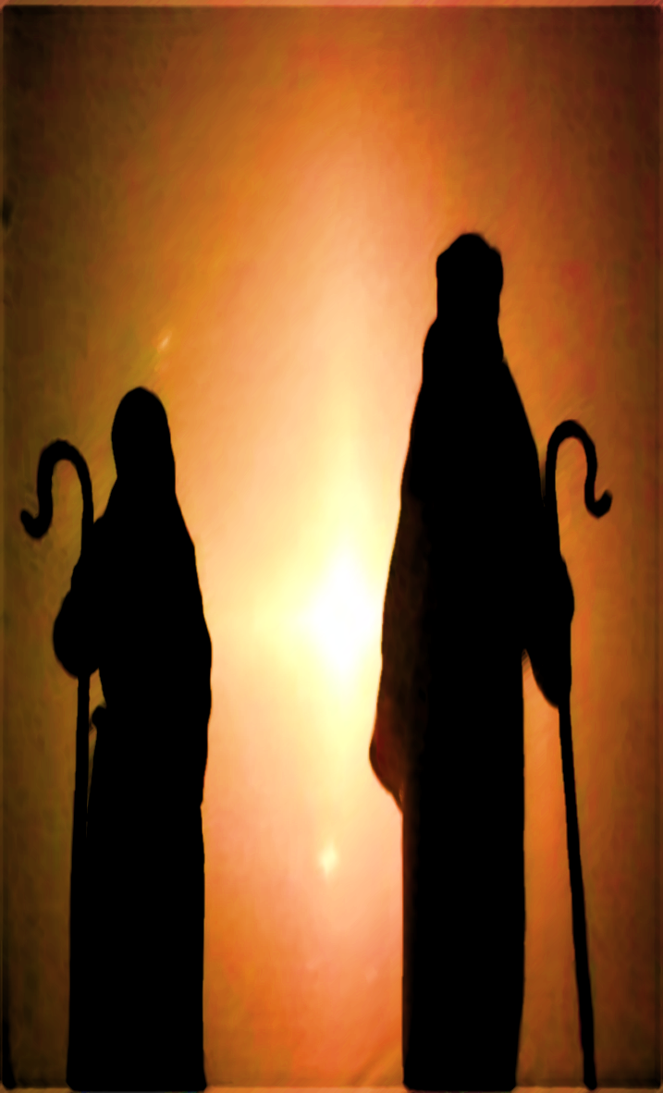
Elders (bishops and pastors)
Churches that have qualified elders have a sacred trust from God
Worthy of honor (1 Tim. 5:17ff)
God’s infinite wisdom desires churches to have a plurality of men serve as elders (Acts 14:23)

Slide 12
Elders (bishops and pastors)
experience
“Elder,” an older man
Not a novice (1 Tim. 3:6)
His domestic life proves his leadership (Titus 1:5, 6)
Able to settle disputes that arise (Acts 15:5, 6; Titus 1:9)

Slide 13
Elders (bishops and pastors)
protection
“Pastor,” one who tends sheep
He ensures the flock is being fed (Acts 20:28)
Watches out for the souls under his care (Heb. 13:17)

Slide 14
Elders (bishops and pastors)
oversight
“Bishop,” a superintendent
He watches out, observes
Verb, “looking carefully” (Heb. 12:15, NKJV)

Slide 15
Are There Men Here
Desiring such a work (1 Tim. 3:1)?
Preparing for such a work?
Qualified for such a work (1 Tim. 3:1-8; Titus 15ff)?
Who can be recognized as such (1 Thess. 5:12, 13)?
“Around the throne were twenty-four thrones, and on the thrones I saw twenty-four elders sitting, clothed in white robes; and they had crowns of gold on their heads” (Rev. 4:4)

